Slide 1
Reducing the dimensionality of data with neural networks
Main paper (Hint0n)
Supplementary paper
Code
Examples on Coursera (also Hinton)

Slide 2
Agenda
Revisit previous lecture: how do nets learn?
Energy and changes in learning weights: how does this net learn?
Autoencoder and PCA: why is this algorithm useful?
Algorithm: how did they do this?
Applications: where did they use this?

Slide 3
Revisiting previous lecture: how do nets learn?
How can we have probabilities as inputs?
Are we feeding in values one by one?
What is the algorithm by which nets learn?
How does back-propagation work for multiple layers?
Are we changing all layers at once or one by one?
How to we train layers if we can’t see them?

Slide 4
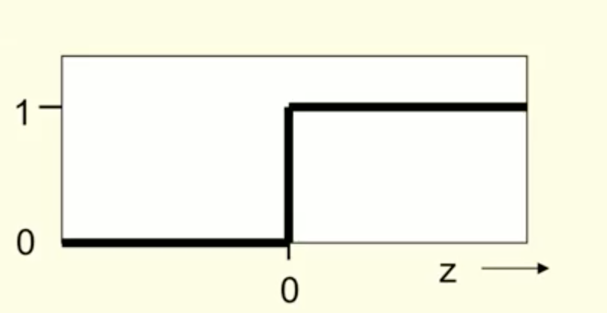
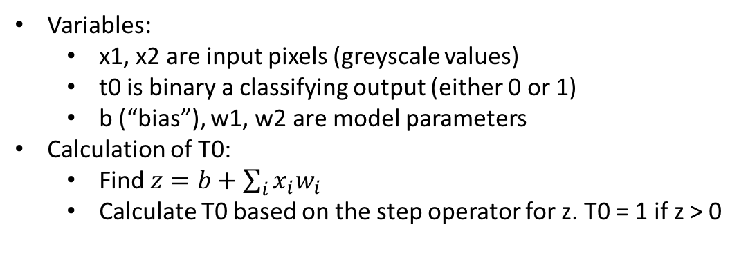
A simple learning algorithm: neuron setup
t0
Is this image a 6?
Variables:
x1, x2 are input pixels (greyscale values)
t0 is binary a classifying output (either 0 or 1)
b (“bias”), w1, w2 are model parameters
Calculation of T0:
Find $z=b+\sum_{i}{x_{i}w_{i}}$
Calculate T0 based on the step operator for z. T0 = 1 if z > 0
b
w1
w2
1
x₁
x₂
Pixel #1
Pixel #2

Slide 5
A simple learning algorithm: learning
Initial model:
b = 0.5
w1 = 2
w2 = -1
t0
1
t0 = 1 BAD!
z = 2
b = 0.5
w1= 2
w2 = -1
b = 0.5
w1= 2
w2 = -1
Calculate t from inputs
Inputs: (0.5, -0.5)
z =0.5 + (2 * 0.5 + -1 * -0.5) = 2
t0 = 1
1
x₁
x₂
1
0.5
-0.5
Retrain weights
t0 should have been 0, so subtract inputs from weights
t0
t0
b = 0.5 - 1
New result is w1 = 1.5, w2 = -0.5, b = -0.5
If weights were correct, we would leave alone
If t0 was 0, should have been 1, then would have added weights
Guaranteed to succeed if possible
w1
= 2 – 0.5
w2
= -1 – 0.5
b = -0.5
w1= 1.5
w2 = -1.5
1
0.5
-0.5
1
x₁
x₂

Slide 6
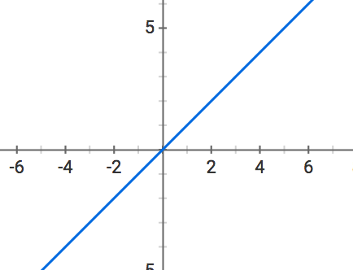
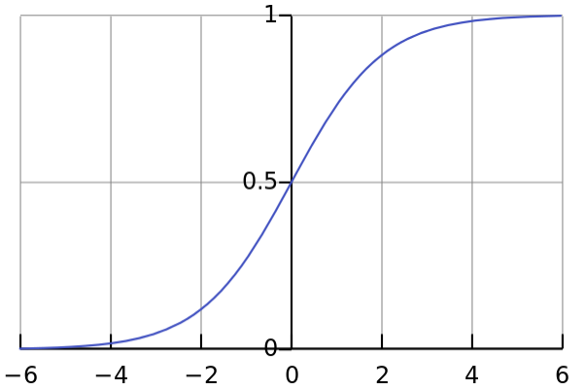
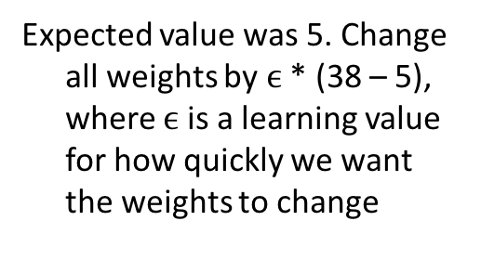
Enhancing the Algorithm: Quantifying error
Allow multiple values for t, and measure how far we are from the target
Use how far we are from the target to adjust the weights, and define a learning rate so we’re not adding the exact same values
Instead of a step function, output a decimal which represents a probability using the logistic function
Define an error function (e.g. squared error)
Expected value was 5. Change all weights by $ϵ$ * (38 – 5), where $ϵ$ is a learning value for how quickly we want the weights to change
38
.79
b = 0.5
w1= 2
w2 = -1
b = 0.5
w1= 2
w2 = -1
1
20
2
1
x₁
x₂

Slide 7
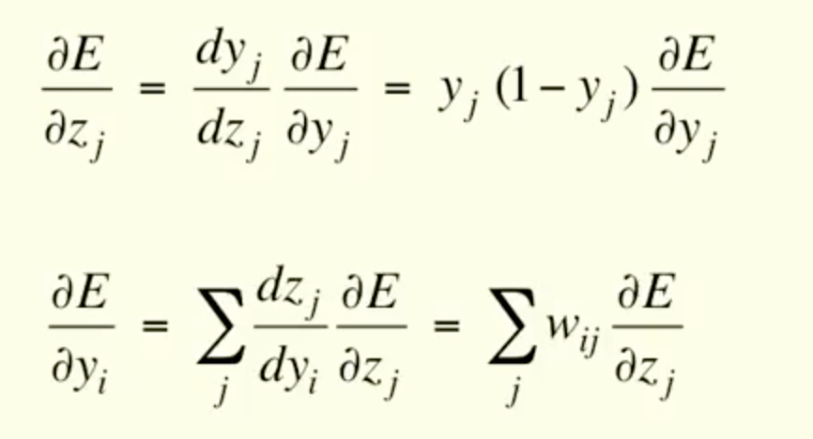
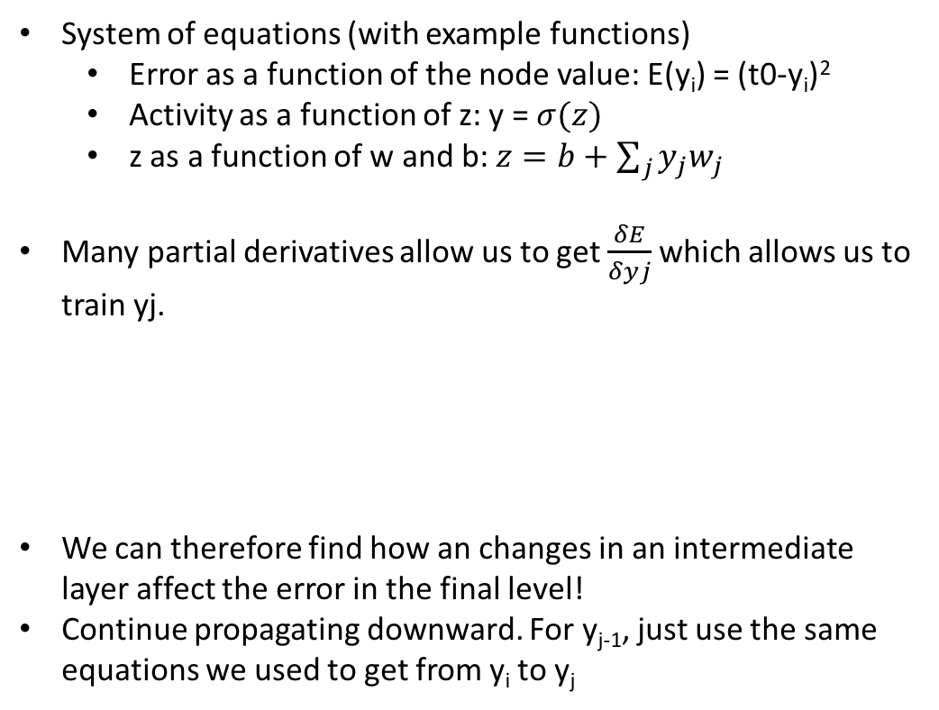
Multi layer networks
If nodes aren’t seen how do we know how to correct them?
yj
System of equations (with example functions)
Error as a function of the node value: E(y_{i}) = (t0-y_{i})²
Activity as a function of z: y = $σ(z)$
z as a function of w and b: $z=b+\sum_{j}{y_{j}w_{j}}$
Many partial derivatives allow us to get $\frac{δE}{δyj}$ which allows us to train yj.
We can therefore find how an changes in an intermediate layer affect the error in the final level!
Continue propagating downward. For y_{j-1}, just use the same equations we used to get from y_{i} to y_{j}
z
b
w_{ij}
yi
1
x₁
x₂

Slide 8



Motivation: PCA
Principle component analysis: taking a lot of data, finding a few vectors to describe it well
Can be used to save memory space
Can store below vectors (3*7 = 21 values) as the first vector and 2 scalars ( 9 values)
$$\left[\begin{aligned}1 \\ 1 \\ 2 \\ −1 \\ 1 \\ 1 \\ 0\end{aligned}\right]$$
$$\left[\begin{aligned}2 \\ 2 \\ 4 \\ −2 \\ 2 \\ 2 \\ 0\end{aligned}\right]$$
$$\left[\begin{aligned}3 \\ 3 \\ 6 \\ −3 \\ 3 \\ 3 \\ 0\end{aligned}\right]$$
We want to do something very similar, except combining components in a nonlinear way

Slide 9
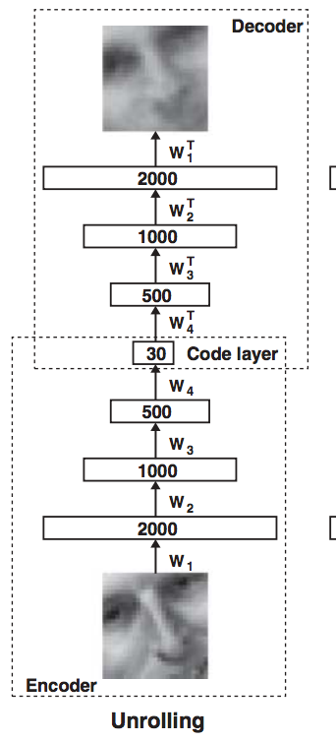
What we’re building: Encode and Decode an Image
Starting with random weights in the two networks, they can be trained together by minimizing the discrepancy between the original data and its reconstruction.
Uses the logistic function to allow for non-linear neurons
Tangent: if the mapping between all networks was linear, it would be equivalent to multiplying several matrices together. Because this can also be represented as a single matrix, it defeats the purpose of having multiple layers.

Slide 10
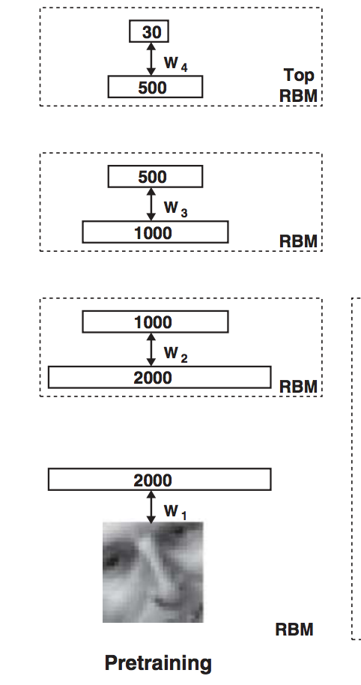
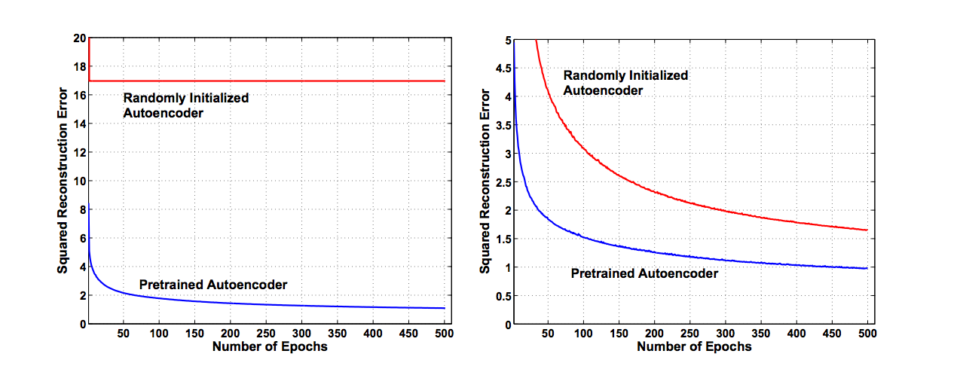
First step in building it: pretraining
Deep Autoencoder
Shallow Autoencoder
It is difficult to optimize the weights in nonlinear autoencoders that have multiple hidden layers
For all datasets, each hidden layer was pretrained for 50 passes through the entire training set
Train with 2 layers -> train with 3 layers -> train with 4 layers

Slide 11
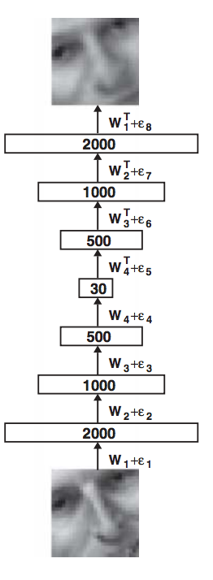
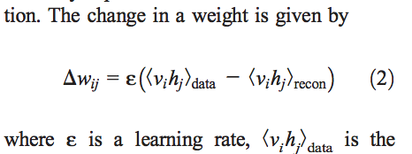
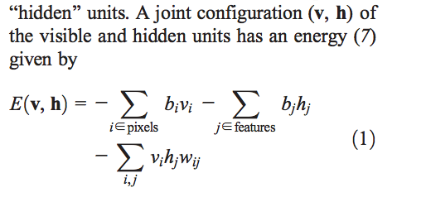
Fine tuning with back propagation
Backpropagation using the chain rule
* Backpropagation first through decoder network, then though encoder

Slide 12
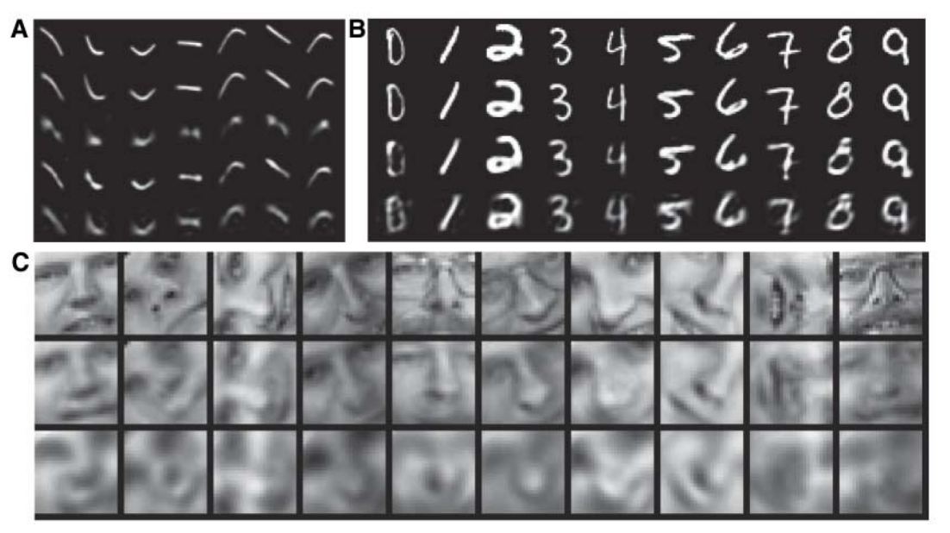
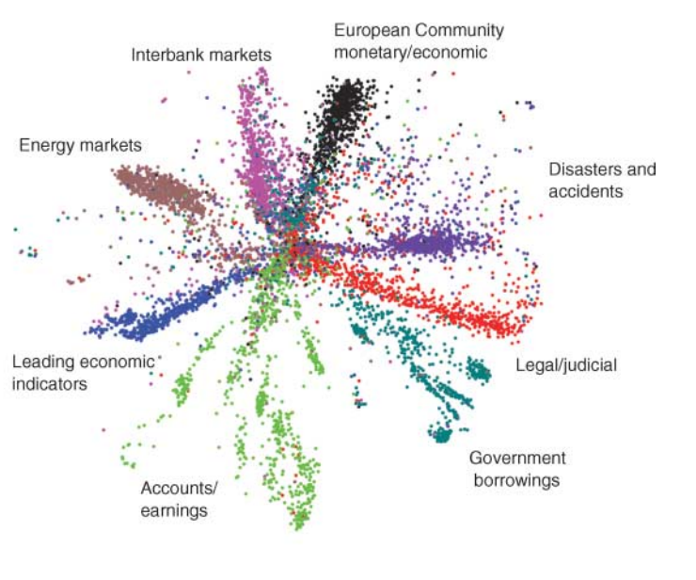
Applications

